Slide 1
New Drugs (and for osteoporosis)
Cost and value of innovation (in 21st century)
Slobodan Vukicevic, School of Medicine, University of Zagreb and Genera Research
9th Croatian Congress on Gynaecological Endocrinology, Human Reproduction and Menopause 05.-09. 2013.

Slide 2
Lifespan
age
26
46
66
76
86
Clean water
Vaccination
New drugs
?????
Prices for large-cap pharmaceutical stocks had been weighed down for years as companies braced themselves to lose their lucrative patents for blockbuster drugs.
Crisis

Slide 3
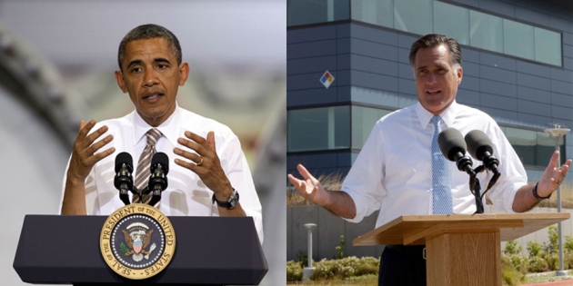
2012: Scientific American 14 top science questions
Innovation and exonomy
Climate change
Research and the future
Pandemics and biosecurity
Education
Energy
Food
Fresh water
Ocean health
Space
Critical natural resources
Vaccination and public health
S&T half of US economy growth since WWII
doubling funding
>3% GDP
Enforce vaccination in interest of public health

Slide 4
Academia
The future of SCIENCE: Regenerative medicine
Regenerative species
ONLY BONE CAN FULY REGENERATE
Adult amphibians, fish and neonatal mice regenerate heart
Ezekiel 36:26 – I will remove from you your heart of stone and
give you a heart of flesh

Slide 5
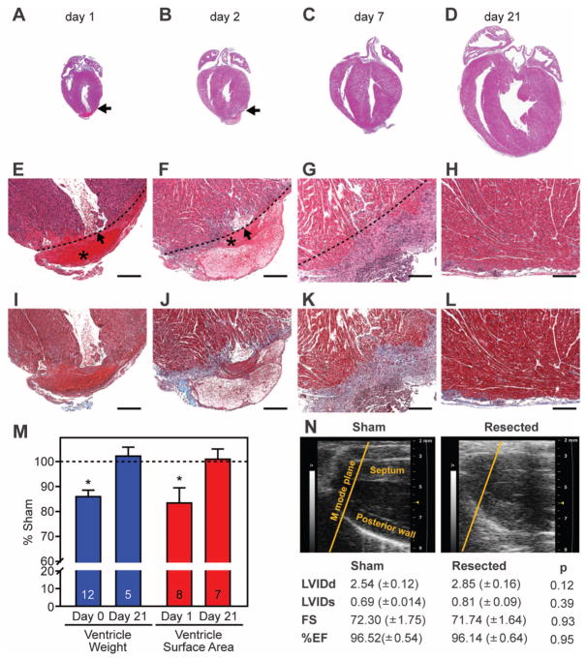
Neonatal mice: Scarless healing – The heart of flesh
Blood clot
Scar
Regeneration
Porrello et al Science 2011

Slide 6
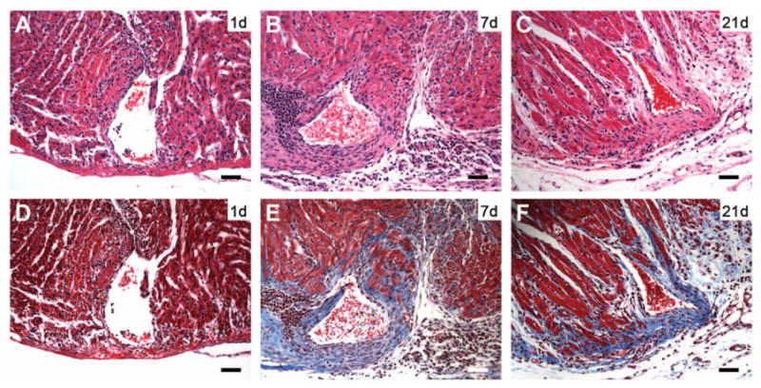
7 day old mice: No regeneration after apical heart resection
Day 1
Day 7
Day 21
Scar formation – The heart of stone
Porrello et al Science 2011

Slide 7
Scarless limb regeneration in adult amphibians and fish

Slide 8
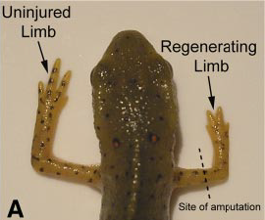
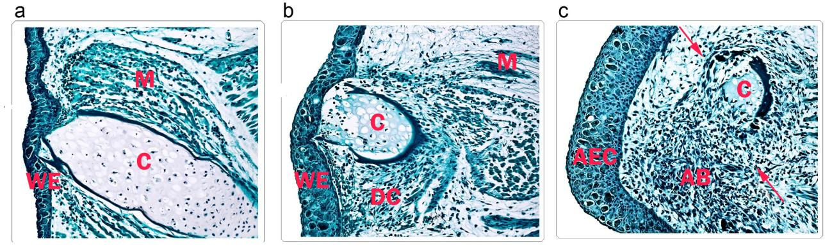
Epimorphic regeneration through creation of a primitive blastema
Axolotl hindlimb regeneration
Rao et al BMC Biol 2009
Day 1
Day 4
Day 7
Wound epidermis histolysis dedifferentiation migration toward WE accumulation of blastema cells

Slide 9
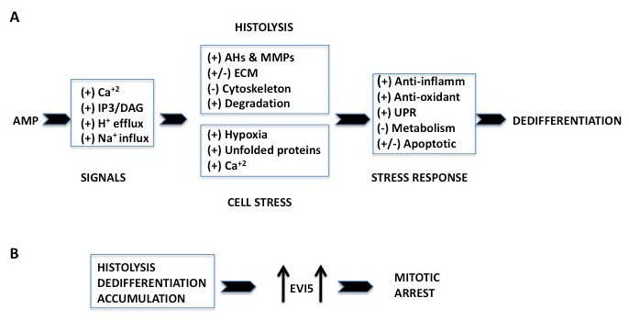
Proteomic analyses of blastema: Diagram of regeneration processes
Amputation
Ecotropic viral integrative factor
Prevents mitosis prior to formation of blastema
Amputation histolysis liberation of cells from ECM
Rao et al BMC Biol 2009; Guimond et al BMC Biol 2010

Slide 10
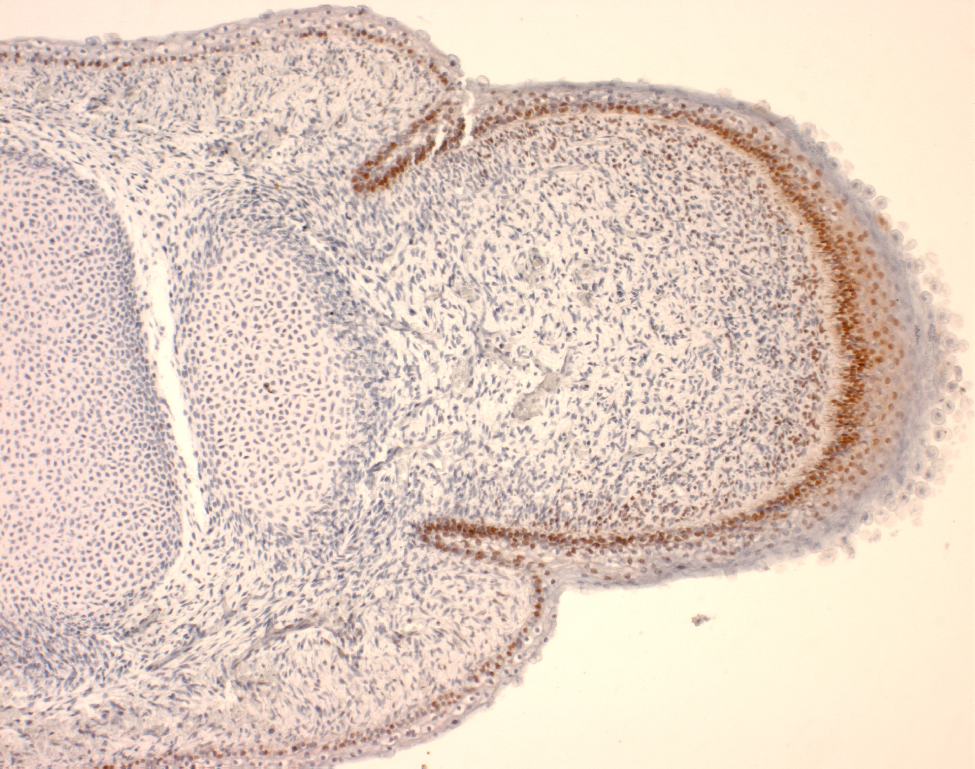
pz
BMP-1-1 + BMP-1-3
+ BMP-7 + BMP-2
m
pz
e
bm
Human development
8 weeks gestation

Slide 11
The future of Pharmaceutical SCIENCE
Innovation crisis of pharmaceutical industry is occuring in new golden age of scientific discovery
No help from customer knowledge, disease expertise and decades of experience in predicting success
US, EU
Croatia
Science, medicine, sport
Sport

Slide 12
1950-2012
FDA approved 1,296 new drugs: 1,167 are small molecules and 145 are biologicals
$50 billion per year
below level required to secure the future of pharmaceutical industry
constant rate: not influenced by technology, mergers, acquisitions, etc.
longevity increased in 60 years for 10 years by an average of 2 months each year

Slide 13
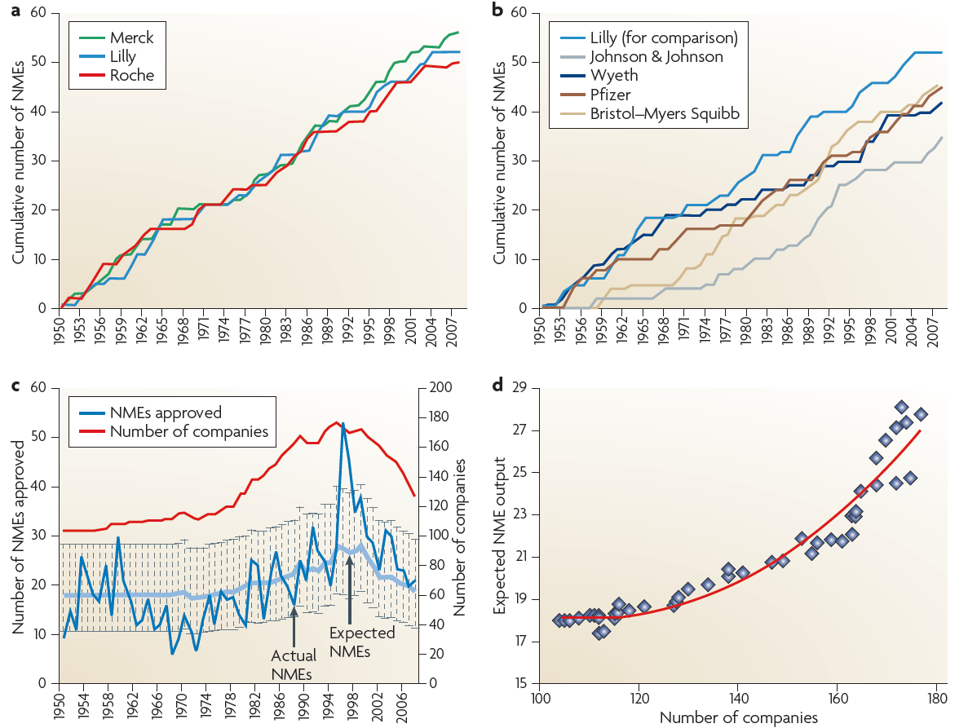
MERCK most productive with 56 approvals, LILLY 51, ROCHE 50

Slide 14
2010
  Pharmaceutical industry spent more than $60 billion on R&D
  FDA approved only 21 new drugs
  Probability that a company’s NME output will exceed 2 or 3 per year is 0.06% and 0.003% = NME output cannot reach threshold of sustainability

Slide 15
Clinical trial
Clinical trail should be resource-effective and patient-centered
Difficult: Design chronic disease trials that require fewer visits for people enrolled
Design
Insulin
Antibiotics
Estrogen-like
Marjorie pancreas extract
SERM: Lasofoxifene
Salvarsan
1 patient
diabetic coma
few hours
1 patient
cured of phemphigus
few days
8570 patients
prevent bone fracture (n=43)
breast cancer (n=27)
5 years
Cost

Slide 16
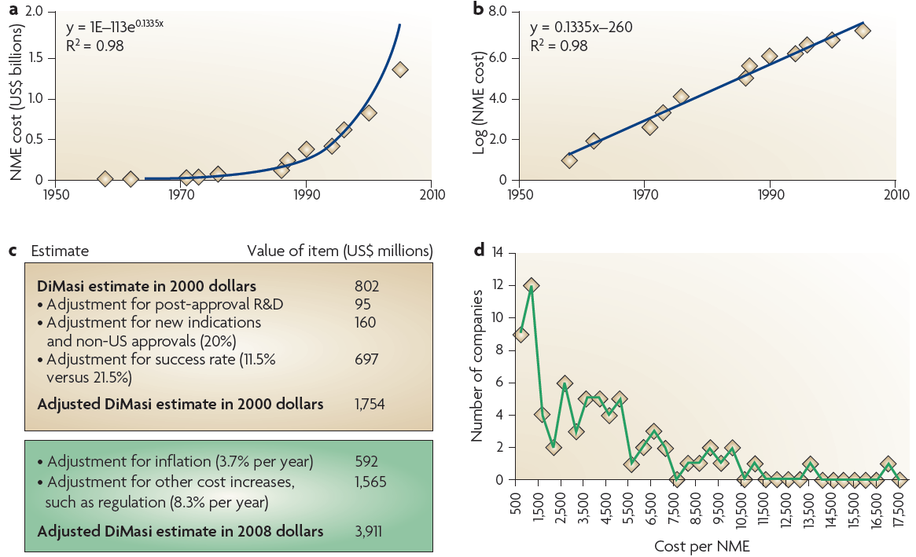
COST

Slide 17
The price of failure
Amgen, CA - $3.7 billion per approved drug (total R&D divided by number of approved agents)
AstraZeneca, UK - $12 billion per drug due to recent late-stage clinical trial failures of drugs for diabetes, depression and ovarian cancer

Slide 18
Solutions?
Standard practice creates little value in industry dominated by blockbuster, like sail forecasts which miss 80% of time
Open innovation
Global brain for best science and ideas wherever they may be
European Innovative Medicines Initiative (http://www.imi.europa.eu/)
Innocentive, chorus, public-private partnership, open-source R&D, X Prize, innovation networks, FIPNet, consortia and various combinations of these and other initiatives
Eli Lilly announced Open Innovation Drug Discovery (https://openinnovation.lilly.com/dd/index.html), available essays and expertise to academic institutions
Pfizer allow others to screen against their internal compound library
GSK created a pool of 800 patents for research of neglected diseases
Across industry most patents remain uncommercialized (90%)
Co-creation involves sharing costs and benefits of innovation

Slide 19
The cause of crisis in pharmaceutical industry research?
Evaluation of Universities:
  8-15% of extraordinary scientists at Harvard, MIT, Berckley, Yale, Hopkins, Oxford, Cambridge
  5-7% at Leuven, Leiden, Lund, Tokyo
  1-2% at Vienna, Rome, London, Moscow, Shanghai
  0.1-0.2% at Zagreb, Ljubljana, Triest
  In the end, innovation comes from one person

Slide 20
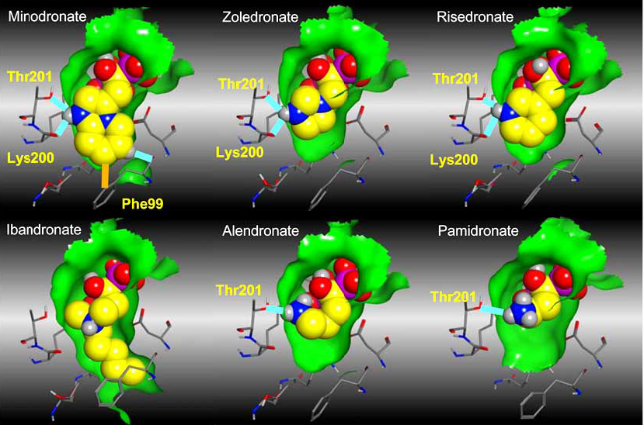
Alendronate: 20 years after

Slide 21

MSD: Gideon Rodan in the field of bone cell biology
Led alendronate from the discovery to FDA approval
Clinical scientist with highest moral integrity.
Clinical trials of alendronate were highly successful
without post-hoc adjustments
Discovered new class of drugs
His outstanding scientific contributions included: isolation and characterization of the first transformed osteoblastic cell line (ROS 17), the dissection of the PTH signal transduction mechanisms, the concept of osteoblast-osteoclast interactions, the cloning of alkaline phosphatase, and the roles of steroids and prostaglandins in bone metabolism. As Director of the Department of Bone Biology and Osteoporosis Research at Merck, he fostered the development of the first bisphosphonate approved for treatment of osteoporosis and provided detailed studies of the mechanisms of action of the bisphosphonates.

Slide 22
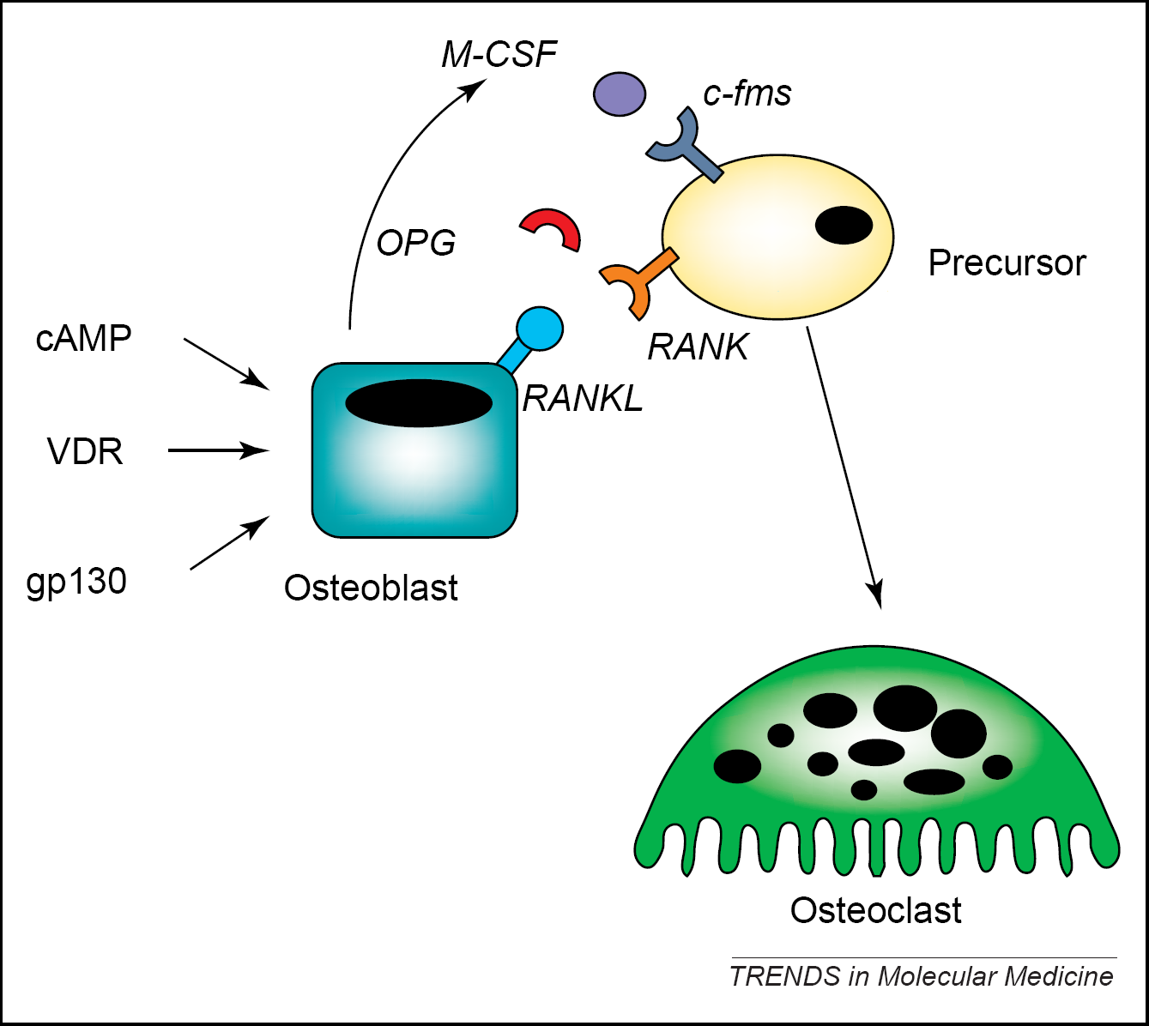
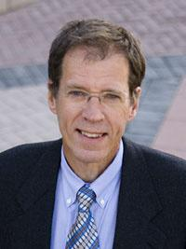
Amgen: David Lacey unravelled the osteoblast osteoclast communication mechanism
Prolia® (denosumab)
XGEVA®

Slide 23
From: History of medical discoveries
200 years of NEJM

Slide 24
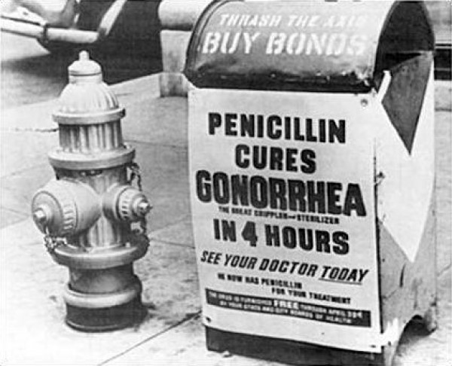
the most serendipitous discovery in the history of science (fortunate discovery by accident)

Slide 25
In 1928, Sir Alexander Fleming:
From NEJM
„While investigating variants of Staphylococcus, Fleming set a number of culture plates aside on a lab bench for future observation. Several days later, he noticed that the cultures had been contaminated by mold spores (Penicillium notatum) and, amazingly, that the Staphylococcus colonies were receding in areas where the mold was growing”.
more than a decade elapsed before it was put into serious clinical use. Adequate supplies were not available, and the applicability of penicillin to various bacterial infections was not yet appreciated. In the 1940s, as Germany began its invasion of Europe, a team of scientists at Oxford started the work that would ultimately allow the mass production of penicillin and realize the amazing therapeutic potential of Fleming’s discovery.

Slide 26
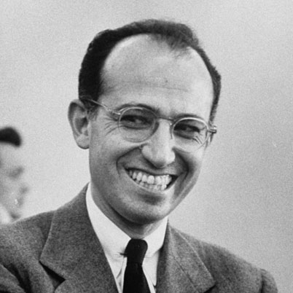
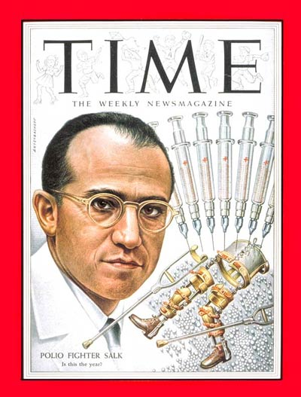
Jonas Salk

Slide 27
The most famous clinical trial ever
Apart from the atomic bomb, America's greatest fear was polio
frantic race to find a way to prevent or cure the disease
U.S. president Franklin D. Roosevelt was the world's most recognized victim
Salk took seven years
"the most elaborate program of its kind in history, involving 20,000 physicians and public health officers, 64,000 school personnel, and 220,000 volunteers." Over 1,800,000 school children took part in the trial
When news of the vaccine's success was made public on April 12, 1955, Salk was hailed as a "miracle worker," and the day "almost became a national holiday."

Slide 28
harsh criticism from the scientific and medical communities
In 1979, polio was declared eradicated from the United States

Slide 29
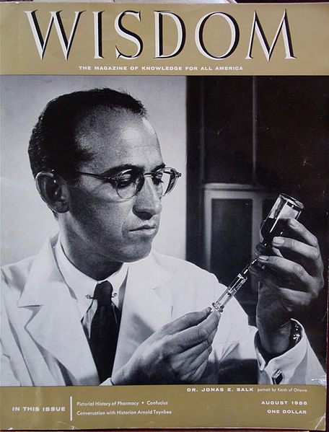
No interest in personal profit
Who owned the patent to the vaccine?
Salk replied:
"There is no patent. Could you patent the sun?"

Slide 30
Back to bones

Slide 31
Novel targets for intervention in postmenopausal osteoporosis
Innovation in research
Cathepsin K Odanacatib Phase III Weekly oral dosing
Sclerostin AMG 785 Phase II Dose ranging
Dickkopf BHQ 880 Phase IIb Multiple myeloma
Serotonin LP533401 Preclinical Bone formation
Nitric oxide Nitroglycerin Increased BMD Topical ointment
Calcium sensing MK5442 Phase II/III Daily oral dosing
receptor
BMP6 OSTEOGROW Phase I Bone repair device

Slide 32

Alendronate: Threats path
bone biomechanics
bone loss after
therapy disconntinuation
osteonecrosis of
jaw
oesophagus cancer
atrial fibrilation
atypical fractures
1993/2003
1998/2003
2005
2006
2007
2008
FIT 3236
FLEX 2852
16,000.000 treated with alendronate
side effects present in 0.24%

Slide 33
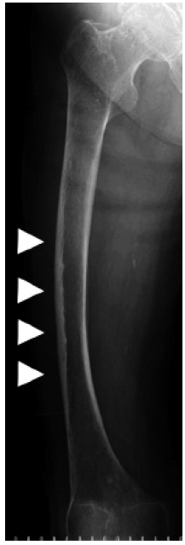
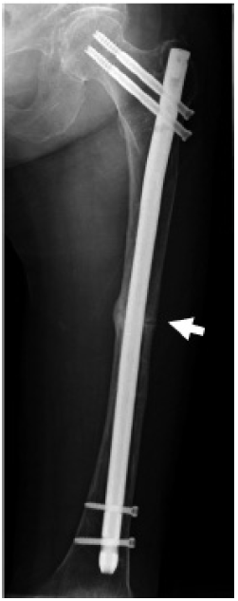
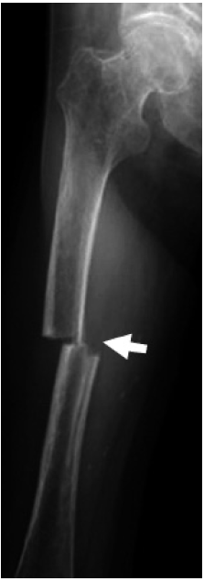
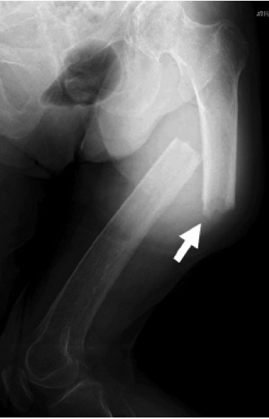
Osugi et al. Acta Orthop
82:112, 2011

Slide 34
Discovery of OSTEOGROW
Osteogenic molecules in human plasma
Treatment of diaphysal and metaphyseal osteoporotic fractures

Slide 35
IPI00003351 | Extracellular matrix protein 1 precursor | 1 | 65 | 11
IPI00029193 | Hepatocite growth factor activator precursor | 1 | 51 | 11
IPI00018305 | Insulin like growth factor binding protein 3 precursor | 1 | 46 | 11
IPI00291136 | Collagen alpha 1 (VI) chain precursor | 1 | 33 | 11
IPI00297284 | Insulin like growth factor binding protein 2 precursor | 1 | 27 | 11
IPI00024825 | Megakaryocyte stimulating factor/lubricin/proteoglycan 4 | 8 | 366 | 12
IPI00029193 | Hepatocite growth factor activator precursor | 6 | 350 | 12
IPI00007634 | PINCH protein /renal carcinoma antigen NY-REN-48 (effector of integrin and growth factor signaling | 2 | 112 | 12
IPI00022822 | Splice isoform 1 of collagen alpha 1 (XVIII) chain precursor | 2 | 123 | 12
IPI00018305 | Insulin like growth factor binding protein 3 precursor | 2 | 61 | 12
IPI00299738 | Procollagen C-proteinase enhancer protein precursor | 2 | 82 | 12
IPI00016915 | Insulin like growth factor binding protein 7 precursor | 2 | 56 | 12
IPI00020977 | Splice isoform 1 of connective tissue growth factor precursor (Hypertrophic chondrocyte specific protein 24)CTGF-major connective tissue mitoattractant secreted by vascular endothelial cells. Promotes proliferation and differentiation of chondrocytes | 2 | 73 | 12
IPI00024887 | Bone morphogenetic protein 6 | 3 | 41 | 12
IPI00029236 | Insulin like growth factor binding protein 5 precursor | 1 | 32 | 12
IPI00022822 | Splice isoform 1 of collagen alpha 1 (XVIII) chain precursor | 4 | 244 | 13

Slide 36
K60 is associated with BMP-6 resistantce to noggin
Engineering BMPs
with super-agonist
activity
Song et al JBC 2010

Slide 37
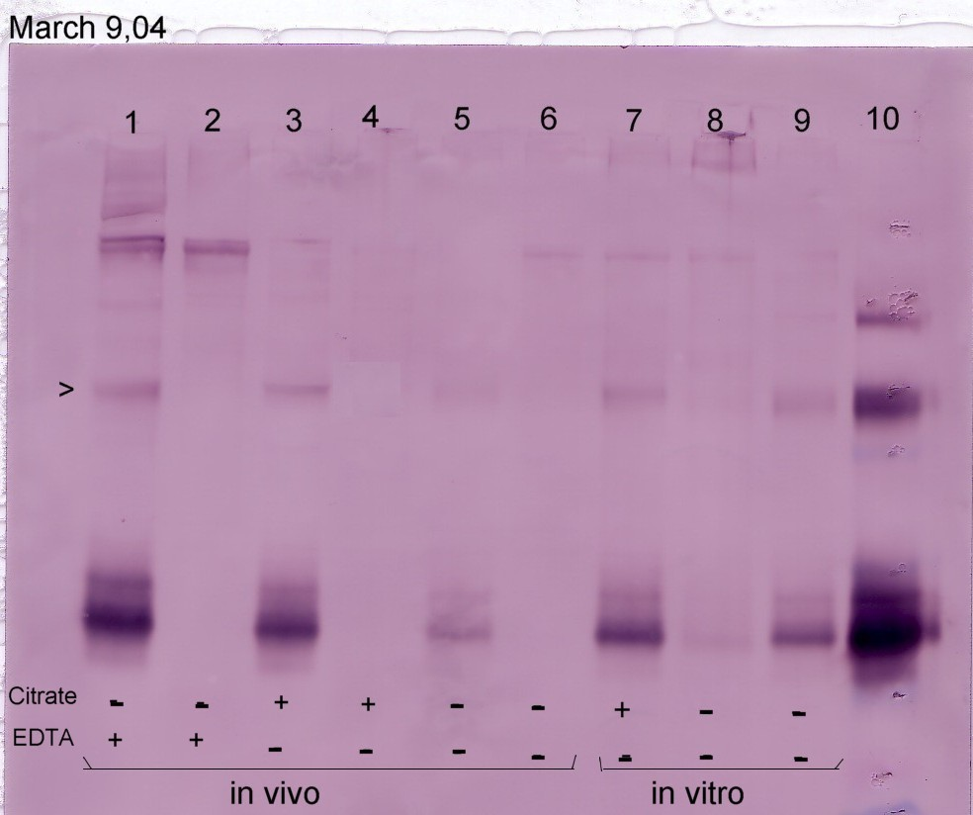
Carrier for BMP-6
*
*
*
*
*
*
*
BMP-6
PLASMA
SERUM
in vivo
in vitro

Slide 38
Autologous carrier for BMPs to replace bovine collagen
in commercial BMP bone devices
Several modification to prepare coagulum maleable, injectable and flexible
Vukicevic, Grgurevic and Oppermann: Whole blood-derived coagulum device for treating bone defects, US 8197840, June 12 2012.

Slide 39
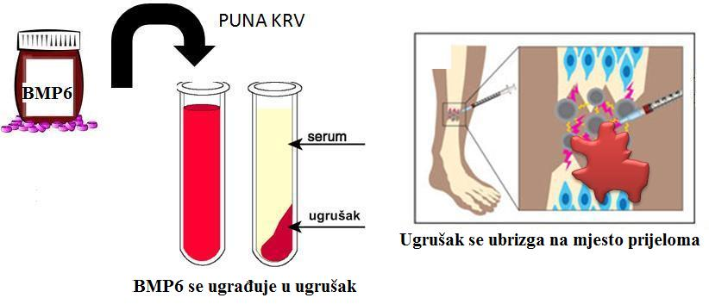
OSTEOGROW formulation
Full blood
serum
clot
Injected between bone ends
binds to clot components

Slide 40
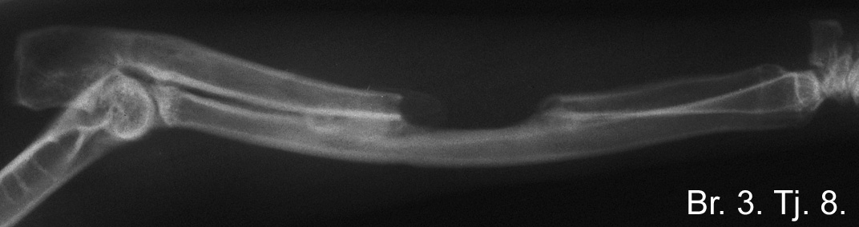
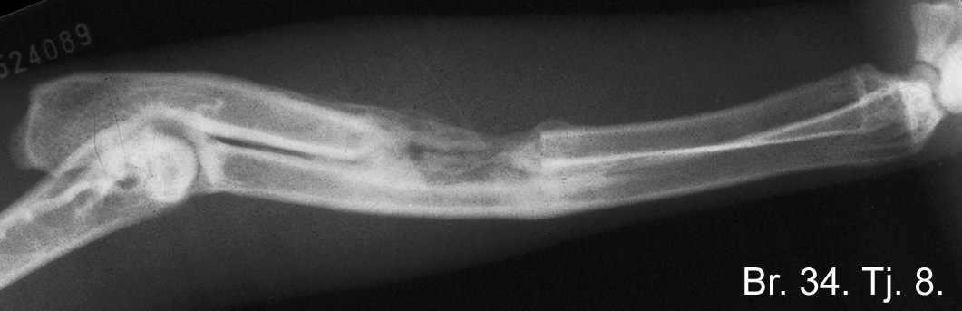
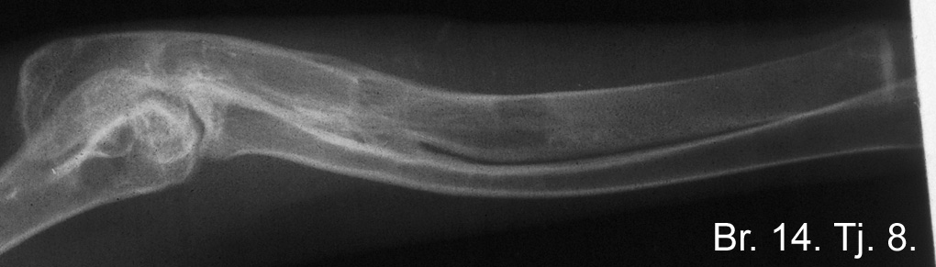
OSTEOGROW: Low dose BMP6
8 weeks
Control
Commercial device
Osteogrow

Slide 41
